Slide 1
Unit 8
Linear Regression

Slide 2
Course Outline
Discuss the importance of linear regression
Use Python modules to implement linear regression

Slide 3
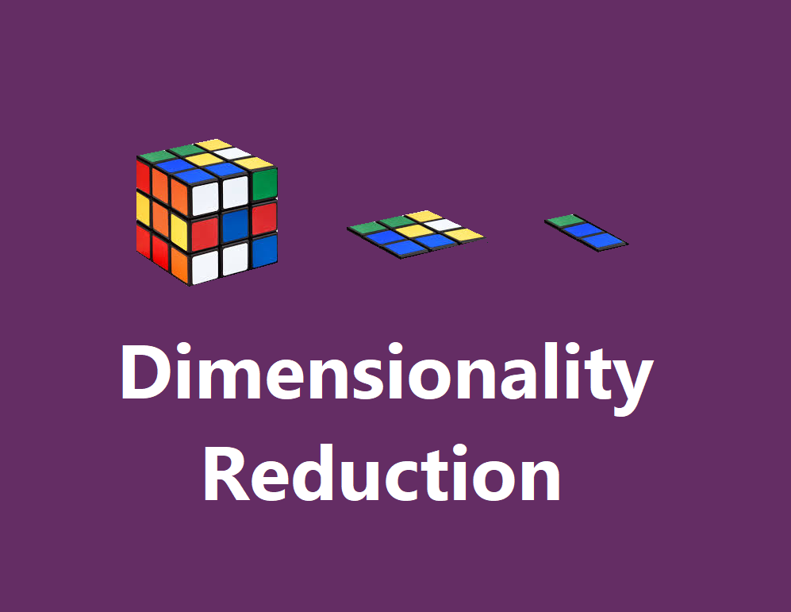
Contents
What is Image
Image Data and their characteristics
Python Libraries involved in Image Processing
OpenCV, Scikit-image and Pillow Library for
loading images
resizing image
cropping images
saving images

Slide 4
What is Regression?
Supervised learning algorithm.
Consists of one or more feature values and a corresponding single output value.
Output is a continuous value.
Learns the line, plane or hyperplane that best fits the training samples.

Slide 5
Linear Regression
Linear Model: assumes linear relationship between input variables (x) and a single output variable (y).
Simple Linear Regression: single input variable (x).
Multiple Linear Regression: multiple input variables (x1, x2,…,xn).

Slide 6
Linear Regression
Given an input x we would like to compute an output y
For example:
- Predict height from age
- Predict Google’s price from Yahoo’s price
- Predict distance from wall from sensors
y
x

Slide 7
Linear Regression
In linear regression we assume that y and x are related with the following equation:
y = b0+b1.x+ε
where ‘b0’ is a intercept at y-axis, ‘b1’ is slope of line, ‘ε’ represents error in measurement or other noise
y
What we are trying to predict
Feature values
x

Slide 8
Cost Function
Cost Function (J): Root Mean Square Error (RMSE) between predicted (y) and actual (y).
$$J=\frac{1}{n}\sum_{i=1}^{n}{{({pred}_{i}−y_{i})}^{2}}$$

Slide 9
Gradient Descent
Method of updating b0 and b1 values, to reduce the RMSE.
Gradient Descent Algorithm:
Start with initial guess of coefficients.
Keep changing the coefficients little bit to try and reduce the cost function J(b0,b1).
Each time the parameters are changed the gradient is chosen which reduces J(b0,b1) the most.
Repeat
Keep doing till no improvement is made.

Slide 10
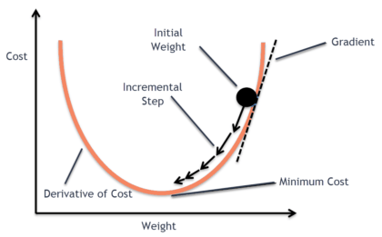
Gradient Descent

Slide 11
Implementation

Slide 12
Implementation
Following Libraries are imported in order to implement the Linear regression successfully.
import numpy as np
import matplotlib.pyplot as plt
import pandas as pd

Slide 13
Implementation
The dataset used here to analyze logistic regression on it is taken from the source https://www.kaggle.com/kamleshsam/student-scores . Storing the file into dataset variable using pd.read_csv function and passing location of the file as an argument.
dataset = pd.read_csv('/content/sample_data/student_scores.csv')

Slide 14
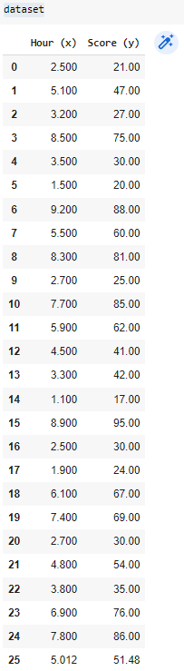
Implementation
Next is just viewing the file to see and observe the values into it.
dataset
Writing the above identifier name the list is fetched and shown as an output.

Slide 15
Implementation
Next is featuring and labelling of the data and storing them for further analysis.
X = dataset['Hour (x)'].values
y = dataset['Score (y)'].values

Slide 16
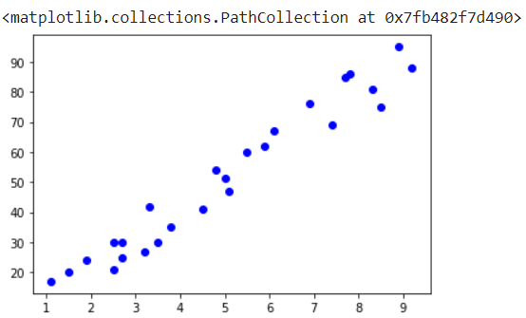
Implementation
Now plotting the data according to the labels.
plt.scatter(X, y, color = 'blue')

Slide 17
Implementation
Now fetching the values of X.
print(X)
[2.5 5.1 3.2 8.5 3.5 1.5 9.2 5.5 8.3 2.7 7.7 5.9 4.5 3.3 1.1 8.9 2.5 1.9 6.1 7.4 2.7 4.8 3.8 6.9 7.8 5.012]

Slide 18
Implementation
Now fetching the values of Y.
print(y)
[21. 47. 27. 75. 30. 20. 88. 60. 81. 25. 85. 62. 41. 42. 17. 95. 30. 24. 67. 69. 30. 54. 35. 76. 86. 51.48]

Slide 19
Implementation
Reshaping to 1-D array.
y=y.reshape(len(y),1)
X=X.reshape(len(y),1)
Splitting the Dataset into training and testing dataset
from sklearn.model_selection import train_test_split
X_train, X_test, y_train, y_test = train_test_split(X, y, test_size = 1/3, random_state = 2)

Slide 20
Implementation
Setting up the model with following code.
from sklearn.linear_model import LinearRegression
model = LinearRegression()

Slide 21


Implementation
Training the model
model.fit(X_train, y_train)
model.coef_
model.intercept_

Slide 22

Implementation
So, Equation will be,
Score = 10.08578922*Hour + 1.81232466
Evaluating the model with following command.
print(model.score(X, y))

Slide 23

Implementation
Predicting on Test data
y_pred = model.predict(X_test)
from sklearn.metrics import r2_score
r2_score(y_test, y_pred)

Slide 24
Implementation
Visualizing the Data for Training Data
plt.figure(figsize=(10, 8))
plt.scatter(X_train, y_train, color = 'blue')
plt.plot(X_train, model.predict(X_train), color = 'green')
plt.title('Training data')
plt.xlabel('Hour')
plt.ylabel('Score')
plt.show()

Slide 25
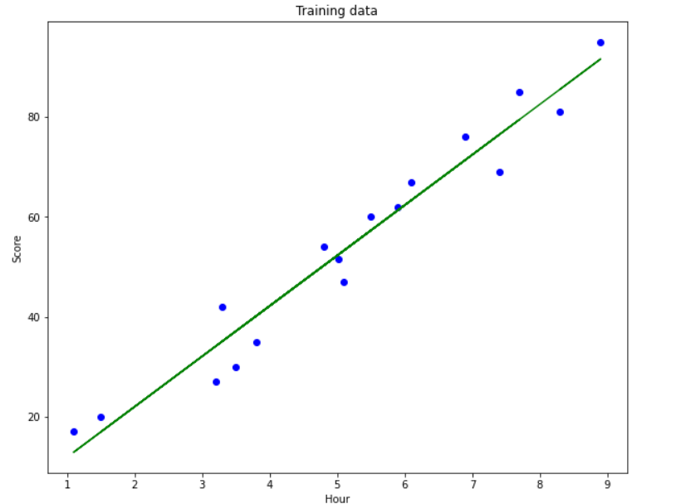
Implementation

Slide 26
Implementation
Visualizing the Data for Testing Data
plt.figure(figsize=(10, 8))
plt.scatter(X_test, y_test, color = 'blue')
plt.plot(X_train, model.predict(X_train), color = 'green')
plt.title('Test data')
plt.xlabel('Hour')
plt.ylabel('Score')
plt.show()

Slide 27
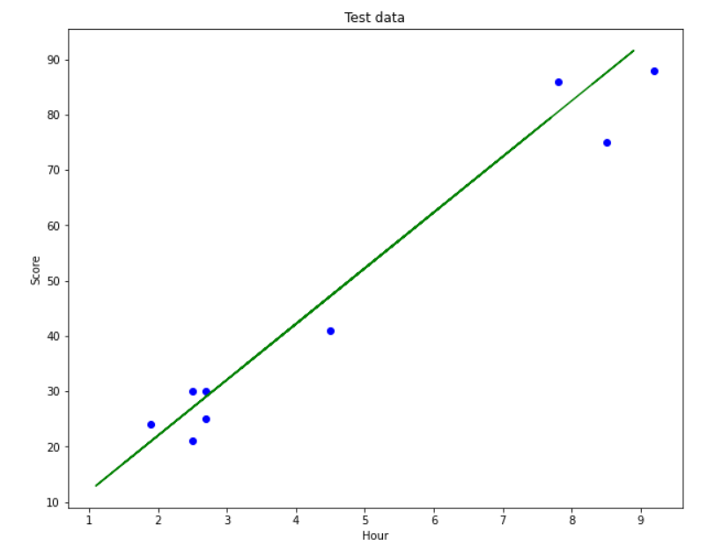
Implementation

Slide 28

Implementation
Predicting on Single value i.e. searching on google for population of india in 2021.
y1 = model.predict([[4.5]]) #search on google for population of india in 2021
print(y1[0]) #list value

Slide 29
Project
Implement Linear regression on a continuous dataset from Kaggle.
Confirm your dataset with your instructor

Slide 30
Reference
https://www.kaggle.com/kamleshsam/student-scores
https://machinelearningmastery.com/linear-regression-for-machine-learning/#:~:text=Linear%20regression%20is%20a%20linear,single%20output%20variable%20(y).&text=Different%20techniques%20can%20be%20used,is%20called%20Ordinary%20Least%20Squares
https://towardsdatascience.com/linear-regression-detailed-view-ea73175f6e86
http://www.stat.yale.edu/Courses/1997-98/101/linreg.htm

